Slide 1
Group 3 Micro Mouse Presentation
By
Suber Abdi w2069210
Gabriel Lopez Narvaez w2090932
Nicholas Nicolaou w2047568
Charanjot Sidhu w2047567
Caleb Suleaudu w1910808
Victoria Veprek w2040013

Slide 2
ALLOCATION and method of tasks
Methods for Group Collaboration
Minutes of Meetings/Logbook - managed weekly, rotating between the group Gantt Chart - chart used to visualise scheduling and task durations GitHub - shared directory for C++ code WhatsApp/Team - for all communication and updates OneDrive - to hold shared documentation and report files
Member | Primary Role/ Tasks | Contribution Rate
Suber | Software/Mechanical - creating the structure of the code and helping with the assembly of the micro mouse | 20
Gabriel | Hardware - creating motor driver circuits, testing for torque, and testing the circuits for shorts | 20
Nicholas | Software – Use of Keil studios, updating GitHub and Testing code on MBED | 20
Charanjot | Software - Use of Keil studios, updating GitHub and Testing code on MBED | 15
Caleb | Hardware - Made ultrasonic sensor and helping with hardware testing | 10
Victoria | Hardware/Mechanical - making the IR-sensors and testing them, also aiding with the assembly of the micro mouse | 15

Slide 3
aim of the Project
The aim of this project is to design and develop an autonomous micro mouse robot capable of navigating an 8 by 8 maze efficiently without prior knowledge of its layout.
This involves integrating embedded systems, including C++ programming, sensor-based wall detection using infrared sensors and an ultrasonic sensor, and precise motor control. Alongside implementing a maze-solving algorithm such as Lee’s algorithm.
The project also aims to produce a reliable and well-tested system that can operate in real-world conditions, while demonstrating effective teamwork, planning and engineering design.

Slide 4
Background theory / Tools used
Tools Used
Keil Studio/mbed.h
Fusion 360
Hardware Tools or Parts (Soldering Iron, Pump, Multi-meter, Power Supply, Voltage Generator, Vero board)
GitHub
Project Management (eg. Gantt Charts)

Slide 5
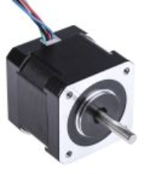
Background theory / Motors used
Stepper Motors
The micro mouse requires two stepper motors which moves current through the motor creating a magnetic field causes the rotor to move. Stepper motors are ideal because they rotate in fixed steps for precise movements used techniques such as half-steps and micro-steps. DC motors are better in speed but for traversing a maze, precise movements are better. [1] [2]
Figure 1: Image of a stepper motor sold by RS components [2]
​

Slide 6
Background theory / Sensors used
Infra-Red Sensor and Ultrasonic Sensors
Infra-Red Sensors work by emitting infrared light and measuring the light reflected. If an object is close, more light is reflected, allowing the system to estimate distance. These sensors are fast and suitable for short-range detection, which makes them ideal for maze navigation. [3]
Ultrasonic sensors, on the other hand, use sound waves. They emit a high-frequency sound pulse and measure the time it takes for the echo to return. Using the speed of sound, the distance to an object can be calculated. [4]

Slide 7
Background theory / Software used
Keil Studio, MBED.h, C++
The key part of the software handles real-time data
The software collects analog data (voltage) at regular intervals , converts it into a digital value
The data collected is used to execute suitable action
The data is also stored to be used for algorithmic logic (Lee's Algorithm)
[5]

Slide 8
Mechanics of a micro mouse
Steps Per Revolution = (360 / Step Angle)
Wheel Circumference = 2 * π * r
Distance Per Step = Circumference / Steps Per Revolution
Total Steps Per Distance = Target Distance / Distance Per Step
Stepping Frequency = Total Steps/ Time (s)

Slide 9
Broader concerns: Sustainability
AA 1.5V Alkaline batteries were selected - don’t have a long lifespan; the micro mouse can hold 8 batteries but it's a high power consumer. 3 batteries only lasted a few days. Wiring and power issues could have caused the batteries to short circuit.
The micro mouse uses stepper motors due to them being precise, but the downside is that they are not energy efficient; will draw current continuously even when not moving. This means wasted energy from the batteries leading to batteries needed to be changed frequently.
Many components are reusable; ultrasonic sensor, motor driver IC, and MBED board chassis and stepper motors. These can all be desoldered and reused for another project.
Disposing of used batteries must be done properly as they contain hazardous material and are flammable
Notes:
AA 1.5V Alkaline batteries were selected - don’t have a long lifespan; it depends on the device youuse them in. Low-drain devices take 1-2 years. Medium-drain devices take 6-12 months and high - drain devices take 2 – 20 hours of active use. Our micro mouse could hold 8 batteries and burntout three within a few days which could have made it a high-drain device. We had some wiring andpowering issues which could have caused the batteries to short circuit.
In our micro – mouse, we used stepper motors due to them being precise, but the downside to thisis that they are not energy efficient; stepper motors will draw current continuously even when notmoving. This means wasted energy on the batteries and may cause the batteries to needreplacement.
Many of our components are still reusable, such as the ultrasonic sensor, motor driver IC, andMBED board chassis and stepper motors. These can all be used again in the creation of a newmicro-mouse.

Slide 10
Broader concerns: Commercial Matters
For the micro mouse project most standard parts were provided like the MBED LPC1768 , L297Stepper Motor Controller , Y129 Unipolar stepper motor and ULN 2003 Motor Driver. As these were provided at no cost, the overall expense for the team was fairly low.
Other components like diodes , resistors , LEDs , switches were also provided for no extra cost.
AA 1.5V alkaline batteries and blue tack were the only expenses

Slide 11
social impact
Skills development - the micro mouse project took place in a STEM learning environment where all the team members improved their technical and soft skills.
Accessibility - all of the core components were provided along with the standard solutions. The team utilised cloud services and social media to communicate effectively and access all shared documents
Innovation – during assembly and testing new factors had to be taken into account; placement of sensors and batteries, weight distribution, distance between sensors and walls

Slide 12
Product life cycles & Risk
Research - decisions made on sensor types, number of sensors, motor types, and chassis design
Required tasks - identifying tasks needed to achieve goal and allocating these
Tasks execution - building the sub systems and unit testing each
System integration - assembling of hardware and software
Testing - debugging code, resolving soldering/wiring issues
Final product - achievement of project and demonstrating it
Notes:
Research – component selection, design decisions
Tasks needed - Task allocation
Task execution - unit testing
System integration – assembly of hardware, assembly of code for different functions
Testing - debugging
Final product - demo

Slide 13
System implementation
Challenge: Navigate an 8 × 8 maze (16 cm × 16 cm cells) , with no prior knowledge of layout, to reach an end point
Sensing: IR + Ultrasonic sensors
Processing: Microcontroller (navigation + decision-making)
Actuation: Stepper motors with motor drivers
Software: C++ (mbed.h) on embedded microcontroller with state machine approach
Power: Low-cost batteries with high capacity and enough output

Slide 14
Hardware Implementation
The system separates the +12V motor supply from the voltage regulator +5V logic rails.
NiMH cells were chosen for its thermal stability, safety, and sustainability compared to other cells.
L297
Converts step/direction into 4 phase unipolar sequences.
ULN2003 chip
Uses internal darlington transistors to sink current from stepper coils. Optimises high torque at low speeds
Pin 9 (COM) connected directly to 12V. This activates internal flyback diodes, which protects the chip from inductive spikes.

Slide 15
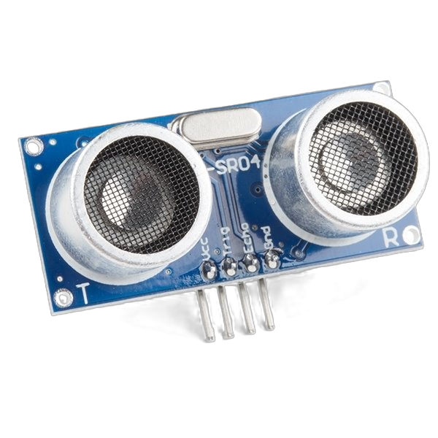
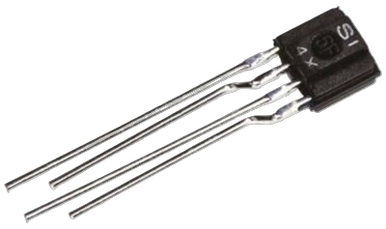
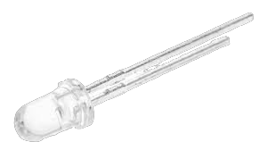
Hardware Implementation
Forward ranging
HC-SR04 sensor uses ultrasonic time-of-flight for front-wall detection.
Lateral IR sensors
IS471 sensors consisting of receiver and emitter detect wall distance.
Figure 2: Image of an ultrasonic sensor (HC-SR04)
Figure 3: Image of an infra-red sensor (IS471)

Slide 16
Implementation
Maze solving algorithm test in fully assembled micro mouse
Distributed vero board modular prototypes for each subsystems
PHASE 1
PHASE 3
Breadboard prototyping and basic MBED loop control
PHASE 2
Assembly, calibration, and software testing
PHASE 4

Slide 17
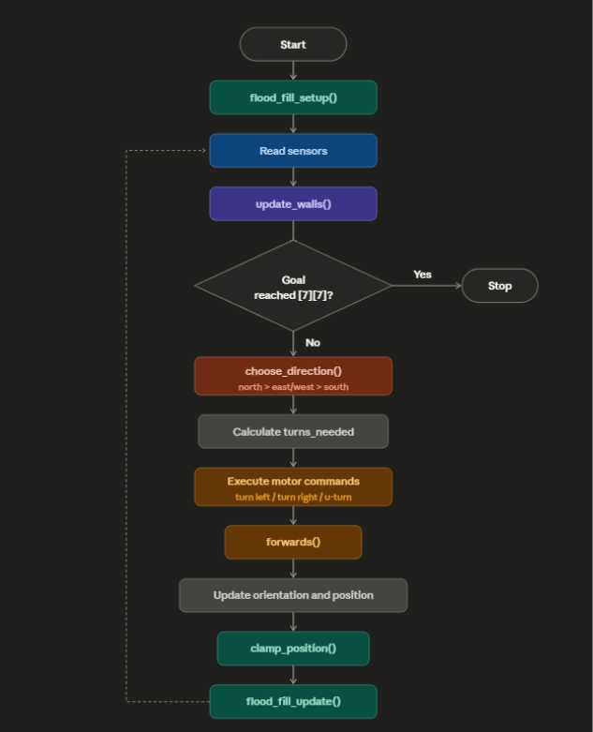
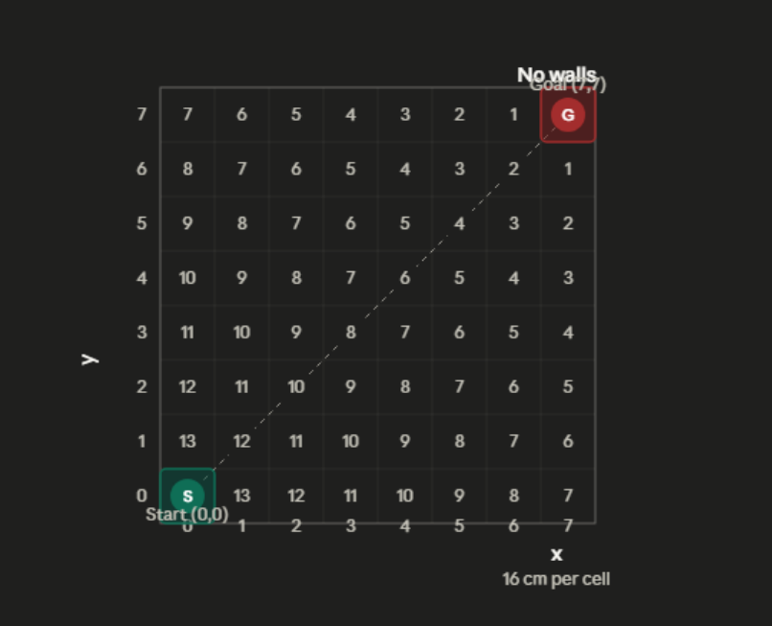
Overall Design & Architecture
Written in C++ on Keil Studio, running MBED OS 6 on the LPC1768
Loop runs cell-by-cell until the goal at [7][7] is reached
Figure 4: Maze without walls
Figure 5: Flowchart of order of process

Slide 18
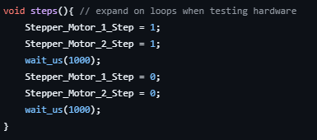


Timing for sensor reads and motor control
Step function:
1000 µs HIGH
1000 µs LOW
So each full step pulse = 2000 µs.
Step rate = 2000 µs per step
(= 2 ms per step)
Figure 6: stepper motor timing
10 microsecond trigger pulse reads at 80mm
Figure 7: ultrasonic timing
Forward, turn left, turn right function:
400 steps per cell
Each step = 2ms
400×2ms = 800ms
Cell traversal time = 800ms
Figure 8: stepper motor rate

Slide 19
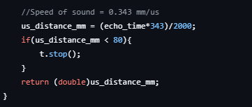
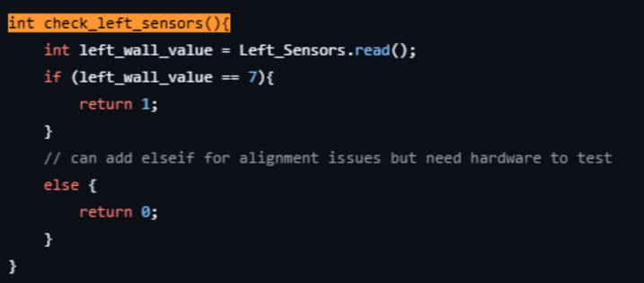
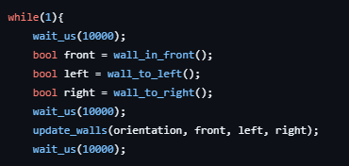

Confidence testing and handling of sensors
Figure 9: ultrasonic
Ultrasonic (front): echo time converted to mm; wall confirmed only if distance < 80 mm
Figure 10: IR arrays Left
IR arrays (left & right): 3 sensors per side; wall only registered if all 3 agree (value = 7), rejecting noisy single-sensor readings
Clamp position: coordinates forced back into 0–7 range if a sensor error causes position drift
Figure 12: clamp function
Figure 11: settling delays
Settling delays: 10 ms wait_us before and after sensor reads to let signals stabilise

Slide 20
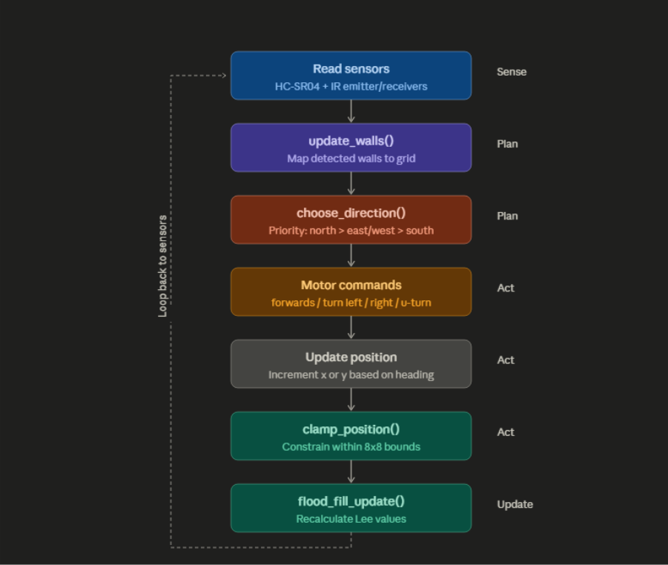
Confidence testing and handling of sensors part2
Sense: the robot reads its ultrasonic and IR sensors to detect walls on the front, left, and right.
Plan: detected walls are mapped into the grid (update_walls()), then choose_direction() uses the flood fill Lee values to pick the best neighbouring cell, prioritising north > east/west > south.
Act: the chosen direction is converted into stepper motor commands (forwards, turn left/right, or u-turn), the robot's tracked position is updated based on its new heading, and clamp_position() ensures the coordinates stay within the valid 8×8 range as a safeguard against sensor errors.
Update: finally, flood_fill_update() recalculates the Lee values to reflect any newly discovered walls, and the loop returns to the sensing stage for the next cell.
Figure 13: block diagram of code priority

Slide 21
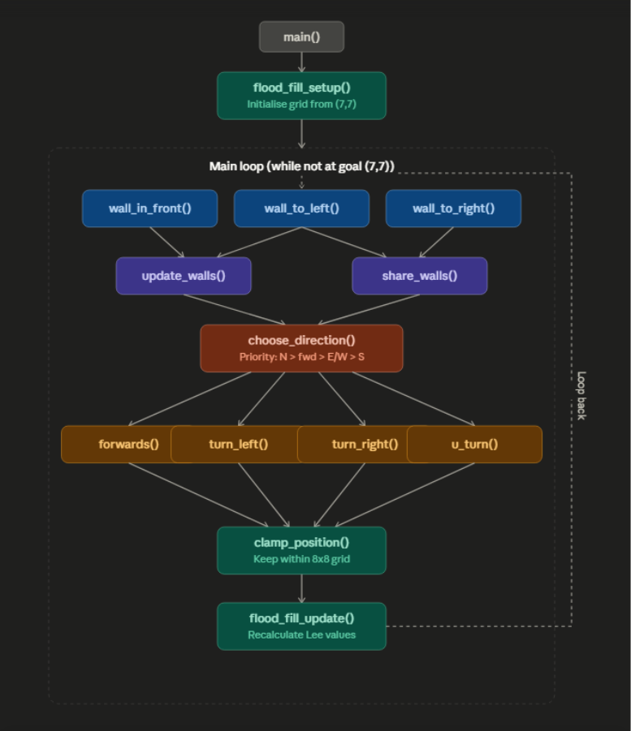
implementation of navigation state machine
Sensing & Mapping: The robot reads ultrasonic and IR sensors, detects walls, and updates a consistent maze‑wall map using update_walls() and share_walls().
Path Planning & Navigation: Flood‑fill (flood_fill_setup() / flood_fill_update()) computes distances to the goal and choose_direction() selects the best neighbouring cell; the main loop turns and moves accordingly while keeping position safe with clamp_position().
Motor Control: Movement is executed through stepper‑motor functions (steps(), forwards(), turn_left(), turn_right(), u_turn()), which generate the required step and direction pulses.
Figure 14: block diagram of function call hierarchy

Slide 22
Results
Unit tested each subsystem to ensure proper and expected function – good method!
This proved that individual sub systems were not faulty – made detecting areas of issues easier
Hardware testing had issues mainly due to unstable connections (soldering) - were resolved
Code was built in stages to ensure individual functions operating without issues
Method and workflow was efficient and effective
Full system integration – unstable results

Slide 23
Conclusion
Achievements:
Subsystems
  IR sensors
  Ultrasonic sensor
  Motors
  Voltage divider
System integration
Temperamental operation
Successful teamwork
Future work:
IR module
DC motors
Heat sink alternative
Improved chassis design for better sensors mounting
Notes:
Acheivements – overall completion %
Future work – heat issue, different way to ?

Slide 24
References
[1] IEEE, “Document 9994475,” IEEE Xplore Digital Library. Available: https://ieeexplore.ieee.org/document/9994475. Accessed: Apr. 27, 2026.
[2] RS Components, “Stepper Motor Guide,” RS Online. Available: https://uk.rs-online.com/web/content/discovery/ideas-and-advice/stepper-motors-guide. Accessed: Apr. 27, 2026.
[3] Sharp Corporation, “Breakbeam Sensor Sharp IS471F Datasheet,” Carnegie Mellon / CSAIL Course Materials, 2014. Available: https://courses.csail.mit.edu/6.141/spring2014/pub/labs/lab7/docs/Breakbeam-Sensor-Sharp-IS471F.pdf.
[4] SparkFun Electronics, “HC-SR04 Ultrasonic Sensor Datasheet,” SparkFun, 2013. Available: https://cdn.sparkfun.com/datasheets/Sensors/Proximity/HCSR04.pdf. Accessed: Apr. 27, 2026. Accessed: Apr. 27, 2026.
[5] IEEE, “MBED OS Documentation,” ARM MBED Platform. Available: https://os.mbed.com/mbed-os/. Accessed: Apr. 27, 2026
[6] University of Westminster, “5ELEN020W Mechanics – Motor Drivers and Selection Procedure,” Module Lecture Notes (PDF), 2026. Accessed: Apr. 27, 2026

